Slide 2
Spark MLlib
Starting with Apache Spark 1.6, the MLlib project is split between two packages:
spark.mllib
spark.ml.
The DataFrame-based API is the latter while the former contains the RDD-based APIs, which are now in maintenance mode.
All new features go into spark.ml.

Slide 3
Spark SQL
This module works well with structured data.
You can read data stored in an RDBMS table or from file formats with structured data (CSV, text, JSON, Avro, ORC, Parquet, etc.) and then construct permanent or temporary tables in Spark.
Also, when using Spark’s Structured APIs in Java, Python, Scala, or R, you can combine SQL-like queries to query the data just read into a Spark DataFrame.

Slide 4
Apache Spark’s Distributed Execution
Spark is a distributed data processing engine with its components working collaboratively on a cluster of machines.

Slide 5
SPARK APPLICATION
Spark Application
Driver Process
Executor Process
Runs your main() function, sits on a node in the cluster, and is responsible for three things:
maintaining information about the Spark Application,
responding to a user’s program or input; and analyzing, distributing, and
scheduling work across the executors (defined momentarily).
Responsible for actually executing the work that the driver assigns them. Each executor is responsible for only two things:
executing code assigned to it by the driver and
reporting the state of the computation, on that executor, back to the driver node.

Slide 6
SPARK APPLICATION
Spark Application
Driver Process
Executor Process
Spark Driver communicate with Cluster Manager for resources.
Transforms all Spark operation into DAG components.
Schedules DAGs and distribute their execution tasks across the executors.
2
1
Cluster Manager
Once the resources are allocated, Driver communicates directly with the Executors.

Slide 7
SPARK APPLICATION
Spark Application
Driver Process
Executor Process
Spark Session
Entry point to Spark.
Subsumes all previous ones in Spark 2.x.
Cluster Manager
It is responsible for managing and allocating resources for the cluster of nodes on which your Spark application runs (e.g., YARN).

Slide 8

DISTRIBUTED DATA AND PARTITIONS
Actual physical data is distributed across storage as partitions residing in either HDFS or cloud storage.
Data Partition
Data Partition
Data Partition
Data Partition
Spark Executor
Spark Executor
Spark Executor
Spark Executor
Though this is not always possible, each Spark executor is preferably allocated a task that requires it to read the partition closest to it in the network, observing data locality.

Slide 9
DISTRIBUTED DATA AND PARTITIONS
How to tune and change partitioning configuration for maximum parallelism based on how many cores you have on your executors?
Data Partition
Data Partition
Data Partition
Data Partition
Spark Executor
Spark Executor
Spark Executor
Spark Executor

Slide 10
SPARK APPLICATION CONCEPTS
How a code is transformed and executed as tasks across the Spark executors?
Application
A user program built on Spark using its APIs. It consists of a driver program and executors on the cluster.
SparkSession
An object that provides a point of entry to interact with underlying Spark functionality and allows programming Spark with its APIs.
Job
A parallel computation consisting of multiple tasks that gets spawned in response to a Spark action (e.g., save(), collect()).
Stage
Each job gets divided into smaller sets of tasks called stages that depend on each other.
Task
A single unit of work or execution that will be sent to a Spark executor.

Slide 11
SPARK APPLICATION CONCEPTS
How a code is transformed and executed as tasks across the Spark executors?
Spark Driver creates a SparkSession object.
The Driver converts you Spark Application into one or more Spark jobs.
The Driver then converts each job into a DAG.
DAG is Spark’s execution plan.
As part of DAG nodes, stages are created based on what operations can be performed.
Each stage is comprised of Spark tasks, or units of execution.
Each task maps to a single core and works on single partition of data.
An executor with 16 core can have 16 or more partitions in parallel.

Slide 12
SPARK TRANSFORMATIONS
Transformations are operations that Spark evaluates lazily.
A huge advantage of the lazy evaluation scheme is that Spark can inspect your computational query and ascertain how it can optimize it.
This optimization can be done by either joining or pipelining some operations and assigning them to a stage, or breaking them into stages by determining which operations require a shuffle or exchange of data across clusters.

Slide 13
SPARK TRANSFORMATIONS
Narrow transformation:
Single output partition is computed from a single input partition.
Filter() or contains()
Wide transformation:
Data from other partitions is read in, combined and written to disk.
Groupby() forces a shuffle of data
Orderby() requires outputs from other partitions

Slide 14
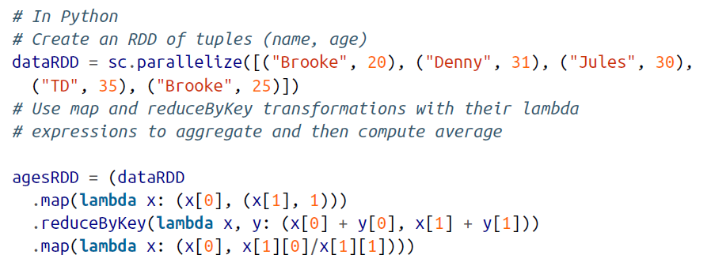
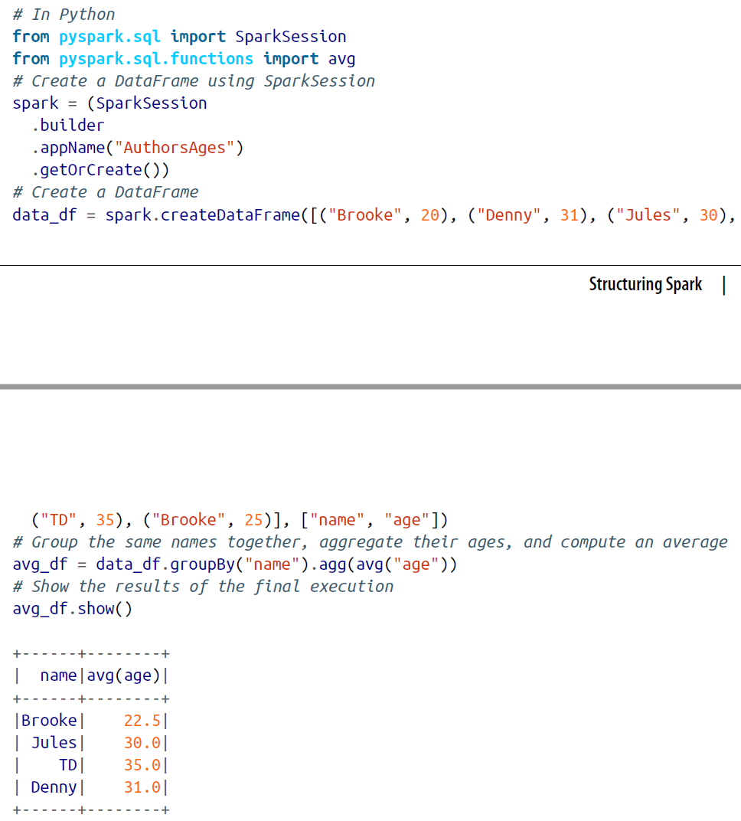
APACHE SPARK’S STRUCTURED APIS
RDD
DataFrame
Spark can inspect or parse the query on the right-hand-side, and understand our intention, it can optimize or arrange the operations for efficient execution.

Slide 15
APACHE SPARK’S STRUCTURED APIS
All of this simplicity and expressivity is possible because of the Spark SQL engine upon which the high-level Structured APIs are built.

Slide 16
DEFINE SCHEMA, DO NOT ASK FOR IT
By defining Schema:
You relieve Spark from the onus of inferring data types.
You prevent Spark from creating a separate job just to read a large portion of your file to ascertain the schema, which for a large data file can be expensive and time-consuming.
You can detect errors early if data doesn’t match the schema.

Slide 17
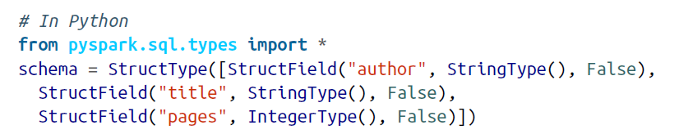

DEFINE SCHEMA, DO NOT ASK FOR IT
Two ways of defining Schema:
Define it programmatically
Employ a Data Definition Language (DDL) string

Slide 18
COMMON DATAFRAME OPERATIONS: WRITE
Parquet, a popular columnar format, is the default format;
It uses snappy compression to compress the data.
If the DataFrame is written as Parquet, the schema is preserved as part of the Parquet metadata.
In this case, subsequent reads back into a DataFrame do not require you to manually supply a schema.

Slide 19
COMMON DATAFRAME OPERATIONS
Because DataFrame transformations are immutable, when we rename a column using withColumnRenamed() we get a new DataFrame while retaining the original with the old column name.

Slide 20
COMMON DATAFRAME OPERATIONS
The DataFrame API also offers the collect() method, but for extremely large DataFrames this is resource-heavy (expensive) and dangerous, as it can cause out-of-memory (OOM) exceptions.
Unlike count(), which returns a single number to the driver, collect() returns a collection of all the Row objects in the entire DataFrame or Dataset.
If you want to take a peek at some Row records you’re better off with take(n), which will return only the first n Row objects of the DataFrame.

Slide 21
WHEN TO USE RDD
When you
Are using a third-party package that’s written using RDDs
Can forgo the code optimization, efficient space utilization, and performance benefits available with DataFrames
Want to precisely instruct Spark how to do a query

Slide 22
SPARK STRUCTURED API
You tell Spark what to do, not how to do it, using high level operations. Then Spark using the Spark SQL engine build efficient queries and generates compact codes for that.

Slide 23
SPARK SQL AND UNDERLYING ENGINE
1. Analysis
2. Logical optimization
3. Physical planning
4. Code generation
In python use:
df.explain(True)
Spark SQL
Catalyst optimizer
Tungsten

Slide 24
SPARK SQL AND UNDERLYING ENGINE
Tableau
Snowflake
…
Spark Application
JDBC/ODBC Connector
Spark SQL Shell
Spark SQL
Hive Tables
JSON
Avro
Parquet
ORC

Slide 25
SQL TABLES
Tables hold data.
Associated with each table in Spark is its relevant metadata, which is information about the table and its data:
the schema
description
table name
database name
column names
partitions
physical location where the actual data resides, etc.
All of this is stored in a central metastore.

Slide 26
USER-DEFINED FUNCTIONS
PySpark UDF:
They have slower performance than Scala UDFs
Expensive data movement between JVM and Python
Pandas UDF:
Introduced as part of Spark 2.3
Uses Apache Arrow to transfer data and Pandas to work with data

Slide 27
PANDAS UDF
Instead of operating on individual inputs row-by-row, you are operating on a Pandas Series or DataFrame (vectorized execution).

Slide 28
PANDAS UDF
From Apache Spark 3.0 with Python 3.6 and above, Pandas UDFs were split into two API categories:
Pandas UDFs
Pandas Function APIs

Slide 29
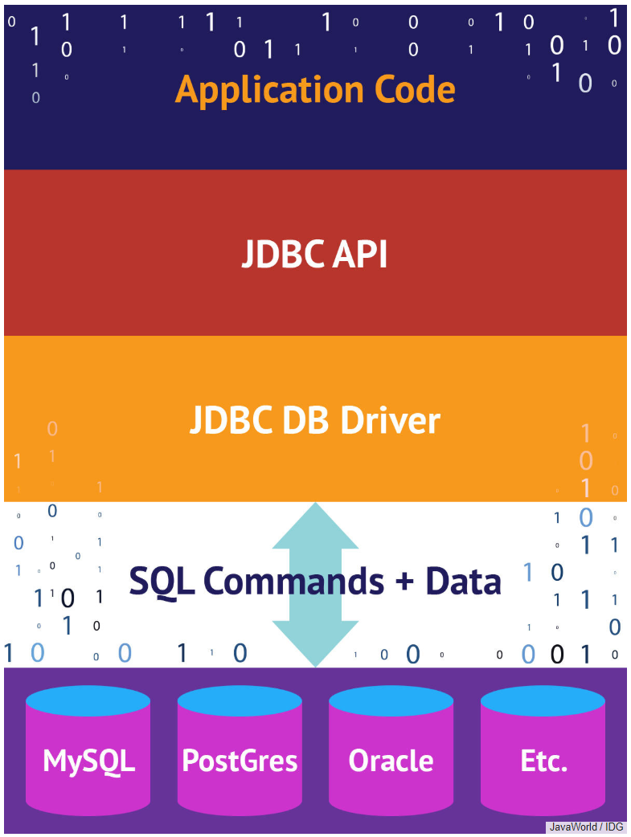
EXTERNAL DATA SOURCES
JDBC and SQL Databases
Spark SQL includes a data source API that can read data from other databases using JDBC.
It simplifies querying these data sources as it returns the results as a DataFrame, thus providing all of the benefits of Spark SQL.
https://www.infoworld.com/article/3388036/what-is-jdbc-introduction-to-java-database-connectivity.html

Slide 30
EXTERNAL DATA SOURCES
JDBC and SQL Databases: The importance of partitioning
When transferring large amounts of data between Spark SQL and a JDBC external source, it is important to partition your data source.
All of your data is going through one driver connection, which can saturate and significantly slow down the performance of your extraction.
It also potentially can saturate the resources of your source system
https://www.infoworld.com/article/3388036/what-is-jdbc-introduction-to-java-database-connectivity.html

Slide 31
DYNAMIC RESOURCE ALLOCATION
When using dynamic allocation:
The Spark driver can request more or fewer compute resources as the demand of large workloads flows and ebbs.
It allows Spark to achieve better utilization of resources, freeing executors when not in use and acquiring new ones when needed.

Slide 32
DYNAMIC RESOURCE ALLOCATION
When spark.dynamicAllocation.enabled enabled.
The Spark driver will request that the cluster manager create spark.dynamicAllocation.minExecutors executors to start with, as a minimum.
As the task queue backlog increases, new executors will be requested each time the backlog timeout spark.dynamicAllocation.schedulerBacklogTimeout is exceeded.
In this case, whenever there are pending tasks that have not been scheduled for over spark.dynamicAllocation.schedulerBacklogTimeout, the driver will request that a new executor be launched to schedule backlogged tasks, up to spark.dynamicAllocation.maxExecutors.
By contrast, if an executor finishes a task and is idle for spark.dynamicAllocation.executorIdleTimeout, the Spark driver will terminate it.

Slide 33
DYNAMIC RESOURCE ALLOCATION
Simply enabling dynamic resource allocation is not sufficient.
You also have to understand how executor memory is laid out and used by Spark so that executors are not starved of memory or troubled by JVM garbage collection.

Slide 34
EXECUTORS’ MEMORY
execution memory
60%
For Spark shuffles, joins, sorts, and aggregations.
storage memory
40%
For caching user data structures and partitions derived from DataFrames
reserved memory
300 M

Slide 35
DATA PARTIOTION
A partition is a way to arrange data into a subset of configurable and readable chunks or blocks of contiguous data on disk.
These subsets of data can be read or processed independently and in parallel, if necessary, by more than a single thread in a process.
This independence matters because it allows for massive parallelism of data processing.

Slide 36
DATA PARTIOTION
On HDFS the default size of file blocks is 128 MB.
The size of a partition in Spark is dictated by spark.sql.files.maxPartitionBytes.
Partitions are also created when you explicitly use certain methods of the DataFrame API.
For example, while creating a large DataFrame or reading a large file from disk

Slide 37
CASH AND PERSIST DATA
They are the same!
But, persist() provides more control over how and where your data is stored
in memory and on disk,
serialized and unserialized.
Both contribute to better performance for frequently accessed DataFrames or tables.

Slide 38
CASH AND PERSIST DATA
In the following situations, do not persist or cash:
DataFrames that are too big to fit in memory
An inexpensive transformation on a DataFrame not requiring frequent use, regardless of size
As a general rule you should use memory caching judiciously, as it can incur resource costs in serializing and deserializing.

